Slide 1

Schoology Scavenger Hunt
task
1
task
2
task
3
start
task
4
Your mission is to complete the 6 scavenger hunt items. There is one challenge on each slide. Have fun!
task
6
task
5
finish

Slide 2

task 1
Where on the blue bar do you check your notifications ? (Drag the ring over your answer)
answer:
NEXT MISSION

Slide 3
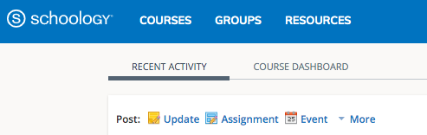
task 2
Where do you find Miss Dormer’s course?
(Drag the ring over your answer)
answer:
NEXT MISSION

Slide 4
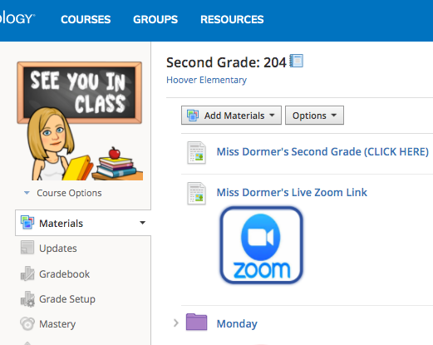
task 3
answer:
Where would you go to join your Zoom video meetings?
(Drag the ring over your answer)
NEXT MISSION

Slide 5
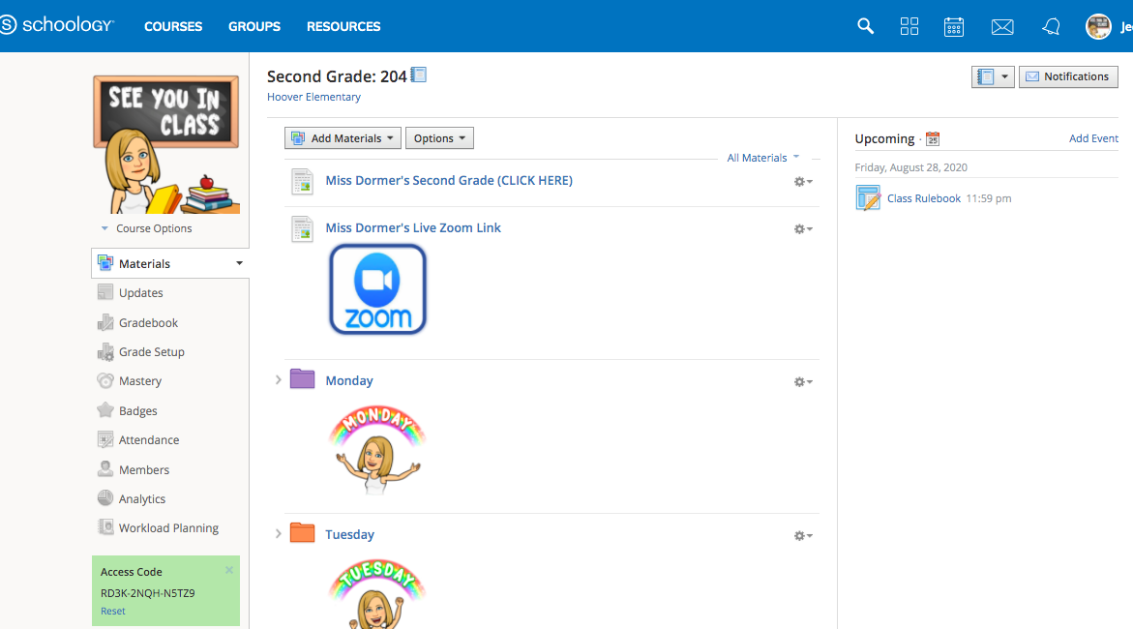
Where do you find all of your assignments for the day?
(Drag the ring over
your answer)
task 4
answer:
NEXT MISSION

Slide 6
task 5
How can you send your teacher a message through Schoology? (Drag the ring over your answer)
answer:
NEXT MISSION

Slide 7
task 6
Where do you find upcoming due dates/ assignments for your course?
(Drag the ring over your answer)
answer:
Finish Mission

Slide 8


Great work!
You are a Schoology Master and are ready for this year!

